Slide 1
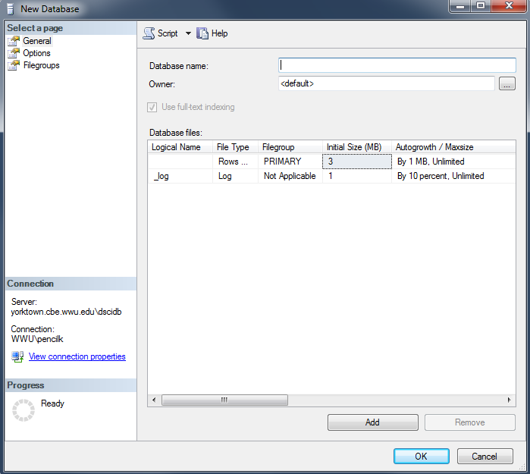
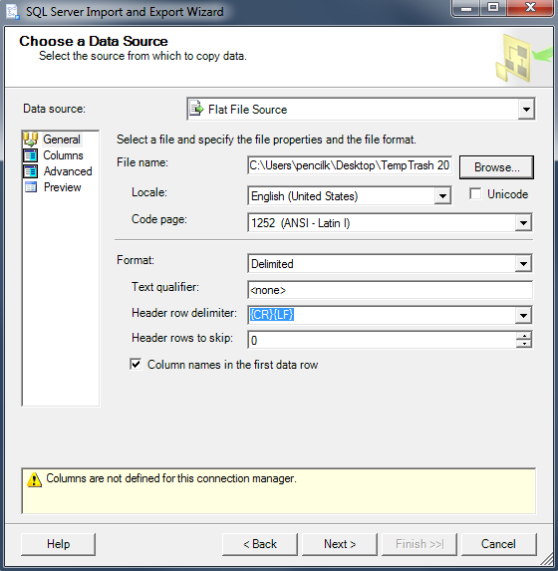
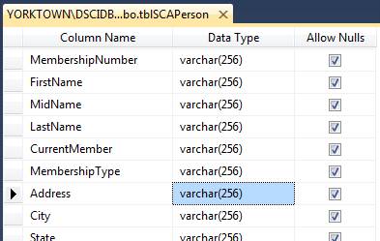
The Sister Cities Database
Development Project
The step described in this set of slides are marked here in red.
Create a database.
Prepare data for importing
Import data; simultaneously … creating the new table
Modify the table design as needed
1. New Database Wizard →
2. Original Data →
2. Prepped Data →
3. Import Wizard →
4: “Design” Window →

Slide 2
Introductory Slides
See “ImportingData - Overview and Preparation of the Database” for an overview, for creating a database and for basic preparation steps.
These slides show you how to simultaneously create the table and import the data using the standalone Import & Export Data tool
Important note: during the Column Mappings step, pay attention to those columns that are automatically set to Float as the data type by the tool
if the values of the column in the destination should be treated as String, such as phone numbers, change the data type to Decimal (38,0)
If the values of the column in the destination should be treated as number,
if the values should contain decimal point, such as revenues, change the data type to Decimal (38,2)
If the values should not contain decimal point, such as population, change the data type to Decimal (38,0)
We use SCAPersons.xlsx as the source data file as the example in this presentation

Slide 3
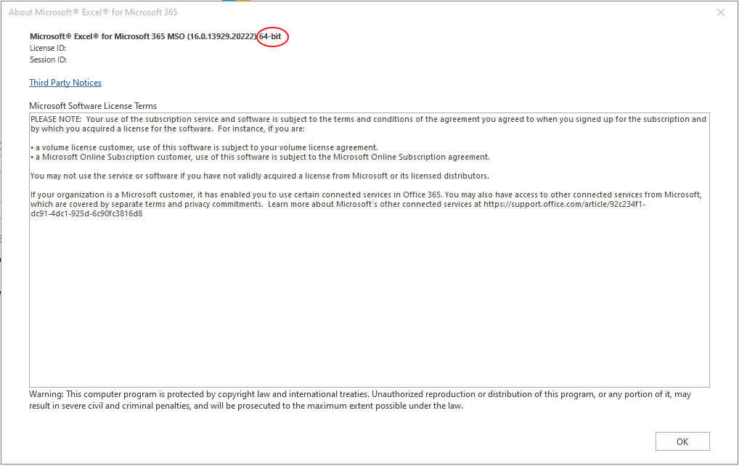
Determine if a 32-bit or 64-bit Excel is installed
For the Excel app in Office 365:
Start Excel
Click Account at the left-bottom of the screen
Click About Excel in the right pane
The window of About Microsoft Excel for Microsoft 365 shows if the Excel is 32-bit or 64-bit (the image to the left shows the 64-bit Excel)

Slide 4
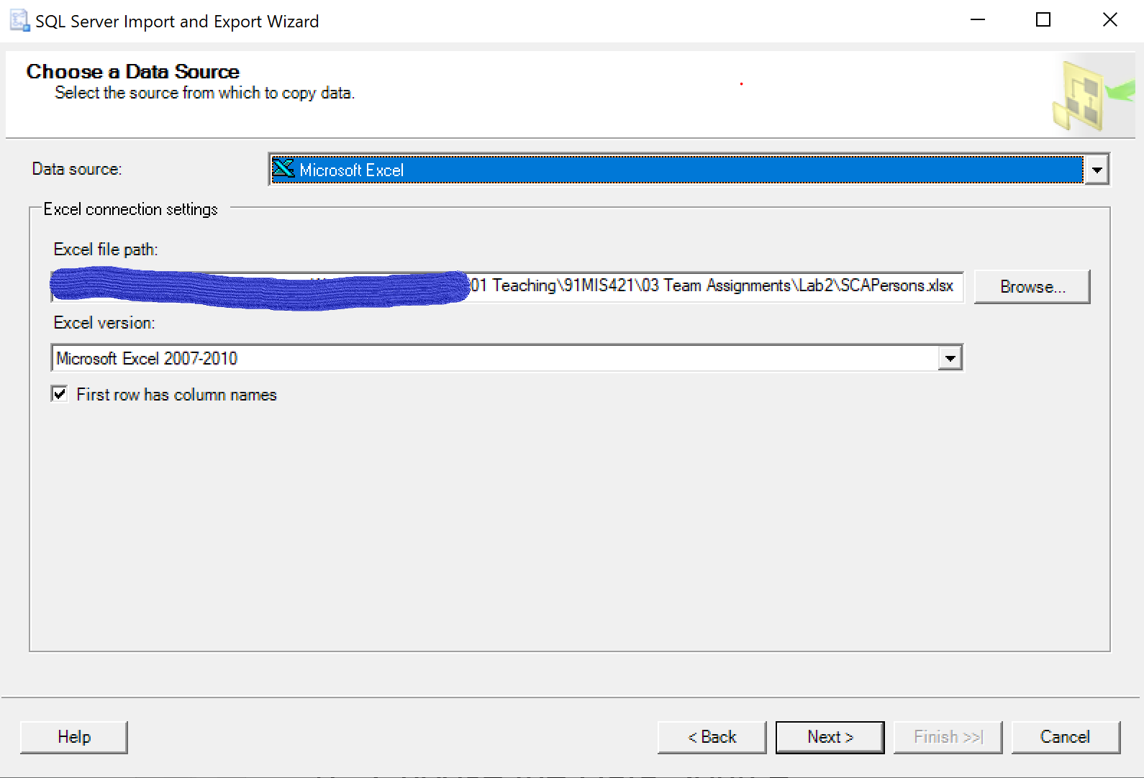
Import the Data using the standalone Import and Export Data Tool
If you have a 64-bit Excel, use SQL Server 2017/2019 Import and Export Data (64 bit); if you have a 32-bit Excel (it is rare now), use SQL Server 2017/2019 Import and Export Data (32-bit)). If these are not installed on your computer, click for the instructions to install it. We use the 64-bit Excel in this example.
From the Windows Program Menu, find and start
SQL Server 2017/2019 Import and Export Data (64 bit)
Click Next on the Welcome window
Choose the Data Source Microsoft Excel and browse to locate the file →
Note these settings (Excel version can be 2007 or later)

Slide 5
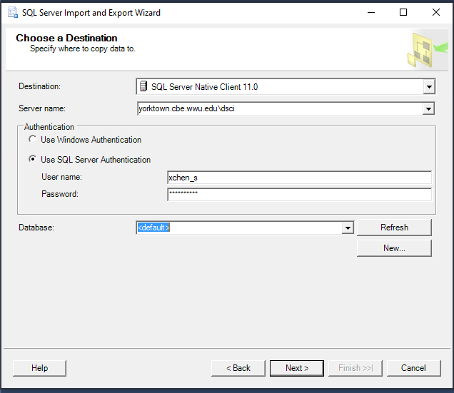
Destination
On the Choose a Destination window, choose Destination and type Server name as shown in the image. Then choose Use SQL Server Authentication and enter your SQL Server username and password.
Choose your database in the dropdown menu for Database
Click Next until you reach the window with “Mailing List$” (illustrated on the next slide)

Slide 6
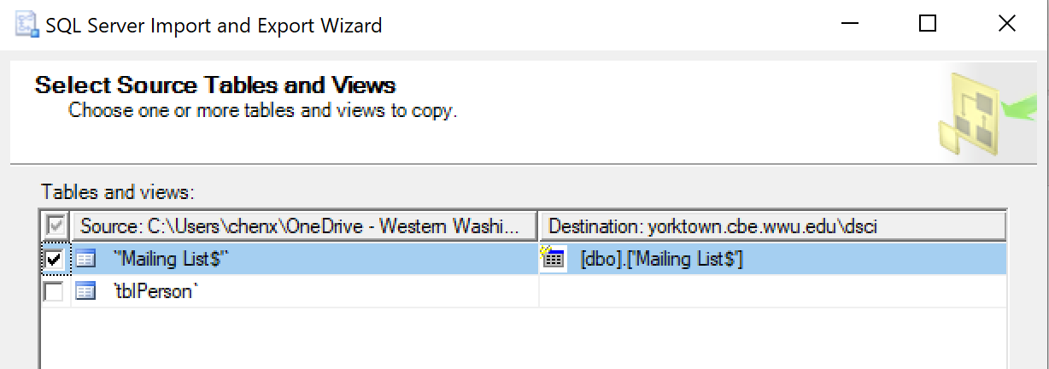
Note: in this example
“tblPerson” is the entire Excel workbook.
“Mailing List$” refers to a tab in the workbook.
Check “Mailing List$” as shown.
Rename Destination to
Click Edit Mappings
Note that you can
name the new table below, or …
rename it after importation is complete.
[dbo].[tblPerson]

Slide 7
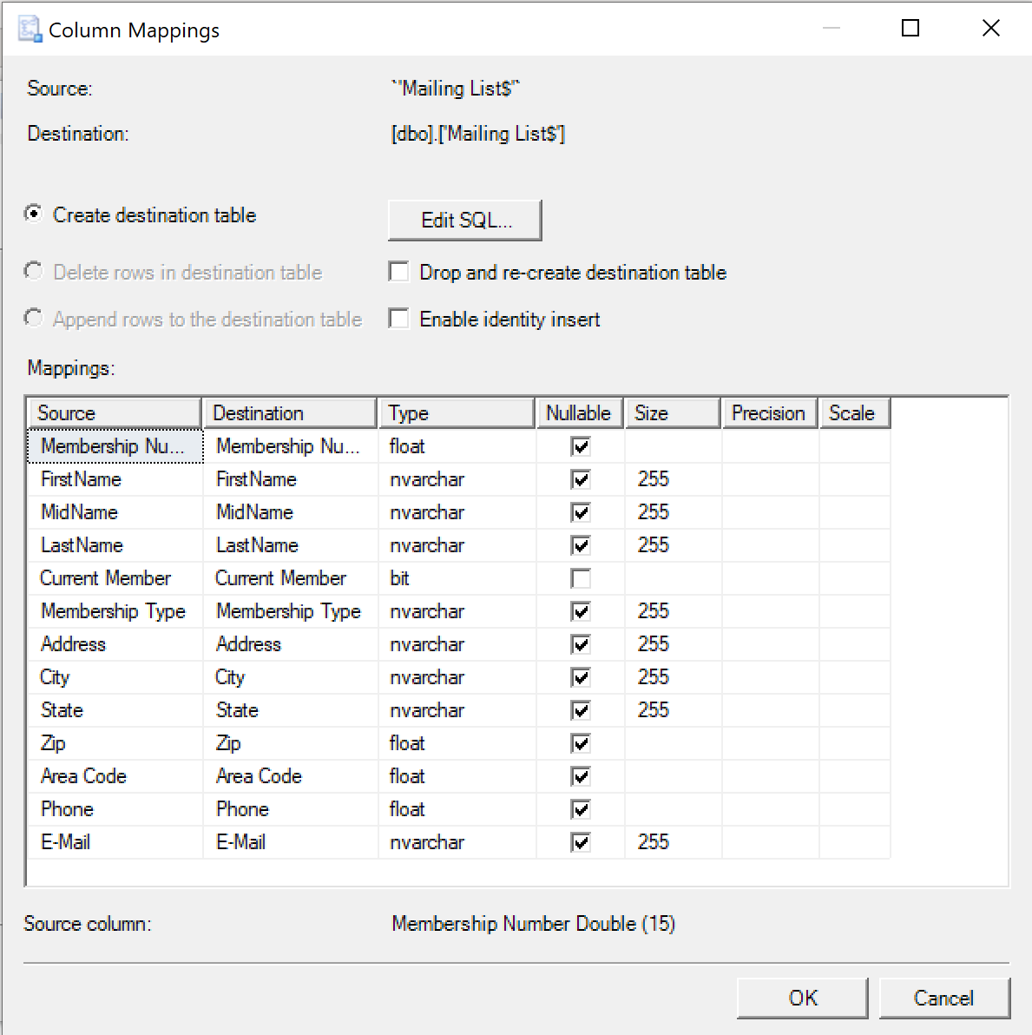
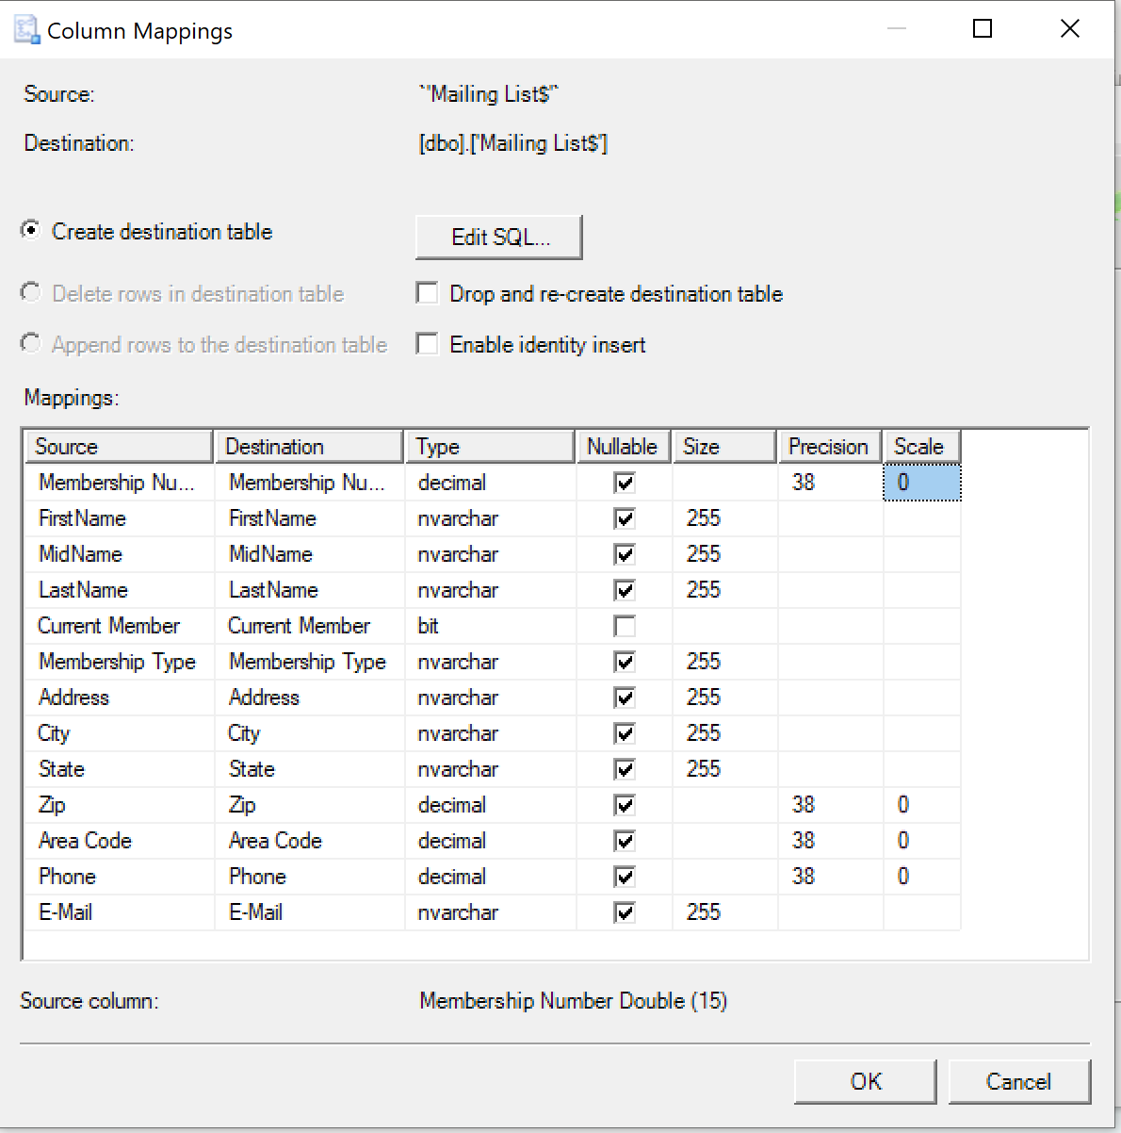
Under “Edit Mappings”, pay attention to those fields that contains data that resemble numbers, but are not numbers, such as Phone. The tool uses float as the default data type for those fields as shown in the left image, which will cause problems when we convert the data type to nvarchar in SQL server. Here we use decimal as the data type for those fields as shown in the right image. In this class, if there is a column that needs a float data type in SQL Server, we always use the decimal data type instead.
You can change other data types after the data is imported into your database
Click OK to close Edit Mappings.

Slide 8
Continue through the import wizard until you reach the last window.
Note: along the way you may encounter the yellow warning symbol that you see above. Ignore it … and keep going to the last window)
IMPORTANT: after you import the data into a SQL Server database table, you need to change in the imported table the data types of columns based on the data specification of MIS 422 and the corresponding columns in production tables based on the final physical data model for each lab.

Slide 9
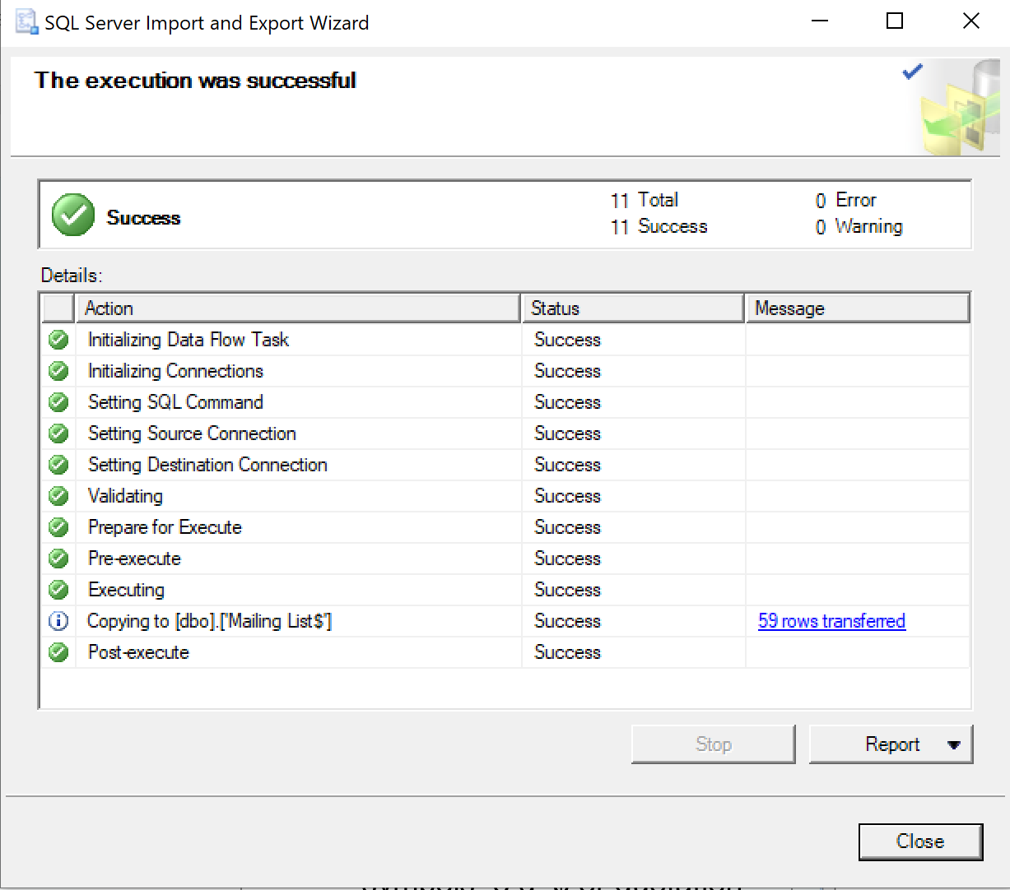
Click the Finish button.
The importation should complete without problem.
Close the wizard.
The new table in your database will be named either 'Mailing List$’
You can rename it in your database when you open it in the Design window

Slide 10
Verify the Import Results
In your database, refresh the table list if the new table does not show in the list
Inspect the table (right-click table name, choose Select Top 1000 Rows) (first 6 rows of data are shown below)
Data in expected columns: verify
Numeric data format: ensure no loss
Character data: check for truncation

